Slide 1
LE26-111 What's new: Enhanced finance analytics
Kennie Nybo Pontoppidan

Slide 2
Business Value
Better reports
Enhanced reporting for deferrals
Faster reports
Faster Excel reports for core finance areas.
In-client analysis
Built-in analysis views for finance and fixed assets
Notes:
LE25-100

Slide 3
Enhanced Finance Analytics (highlights)
Added subtotals to Excel layouts for the built-in deferral reports
Faster Finance Excel reports
Analysis tabs added to finance pages
Enhanced Financial Reporting
Demo data for fixed assets

Slide 4
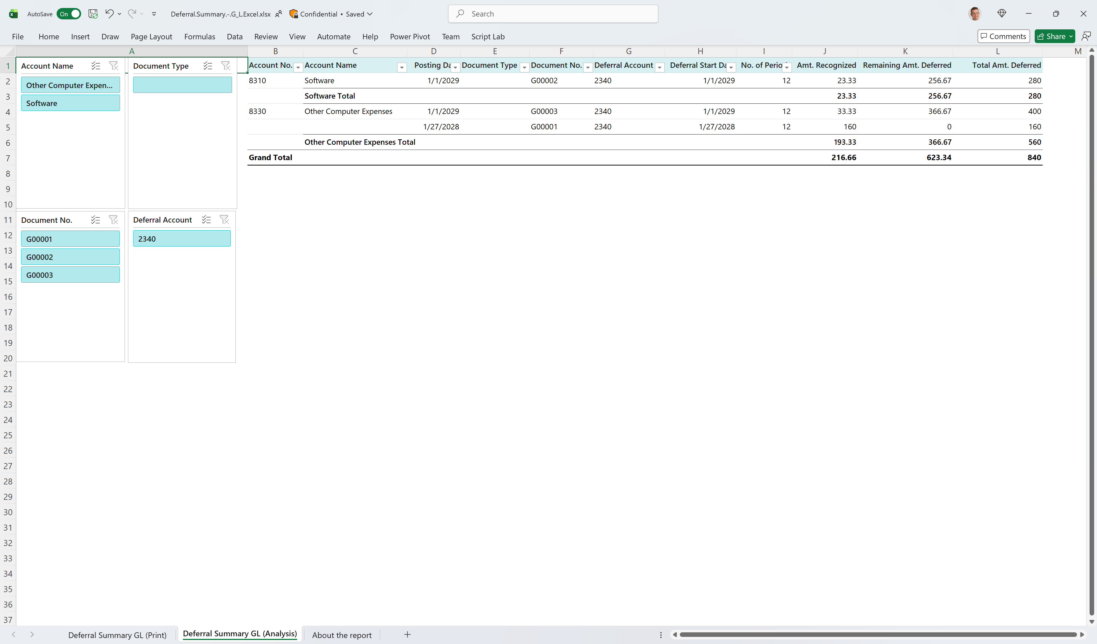
Added subtotals to Excel layouts for the built-in deferral reports
Deferral Summary - GL
Deferral Summary - Purchase
Deferral Summary - Sales

Slide 5
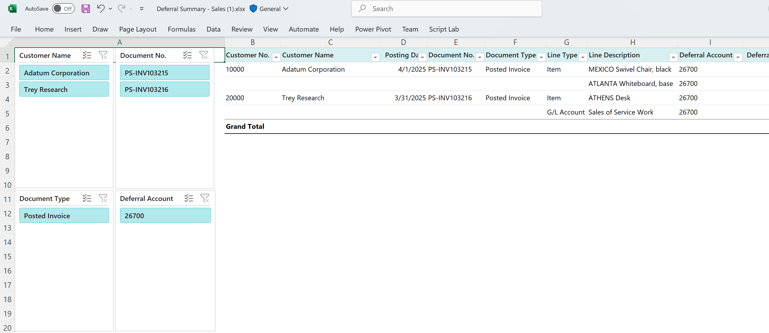
In 2025 release wave 2

Slide 6

Now in 2026 release wave 1

Slide 7
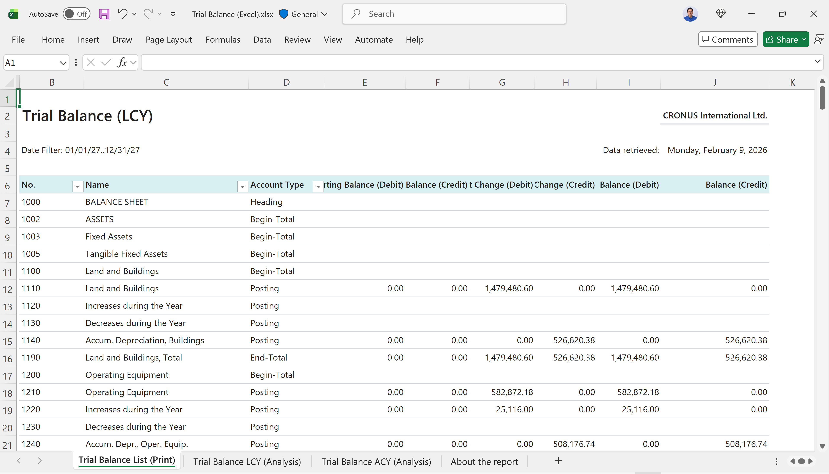
Faster Finance Excel reports
Trial Balance
Consolidated Trial Balance
Trial Balance/Budget
Trial Balance by Period
Trial Balance Previous Year

Slide 8
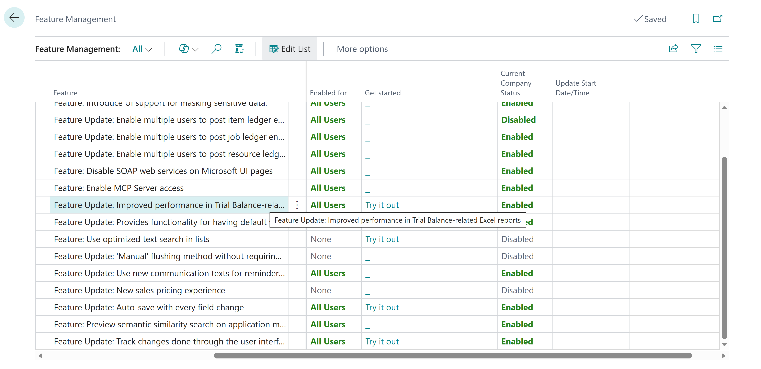
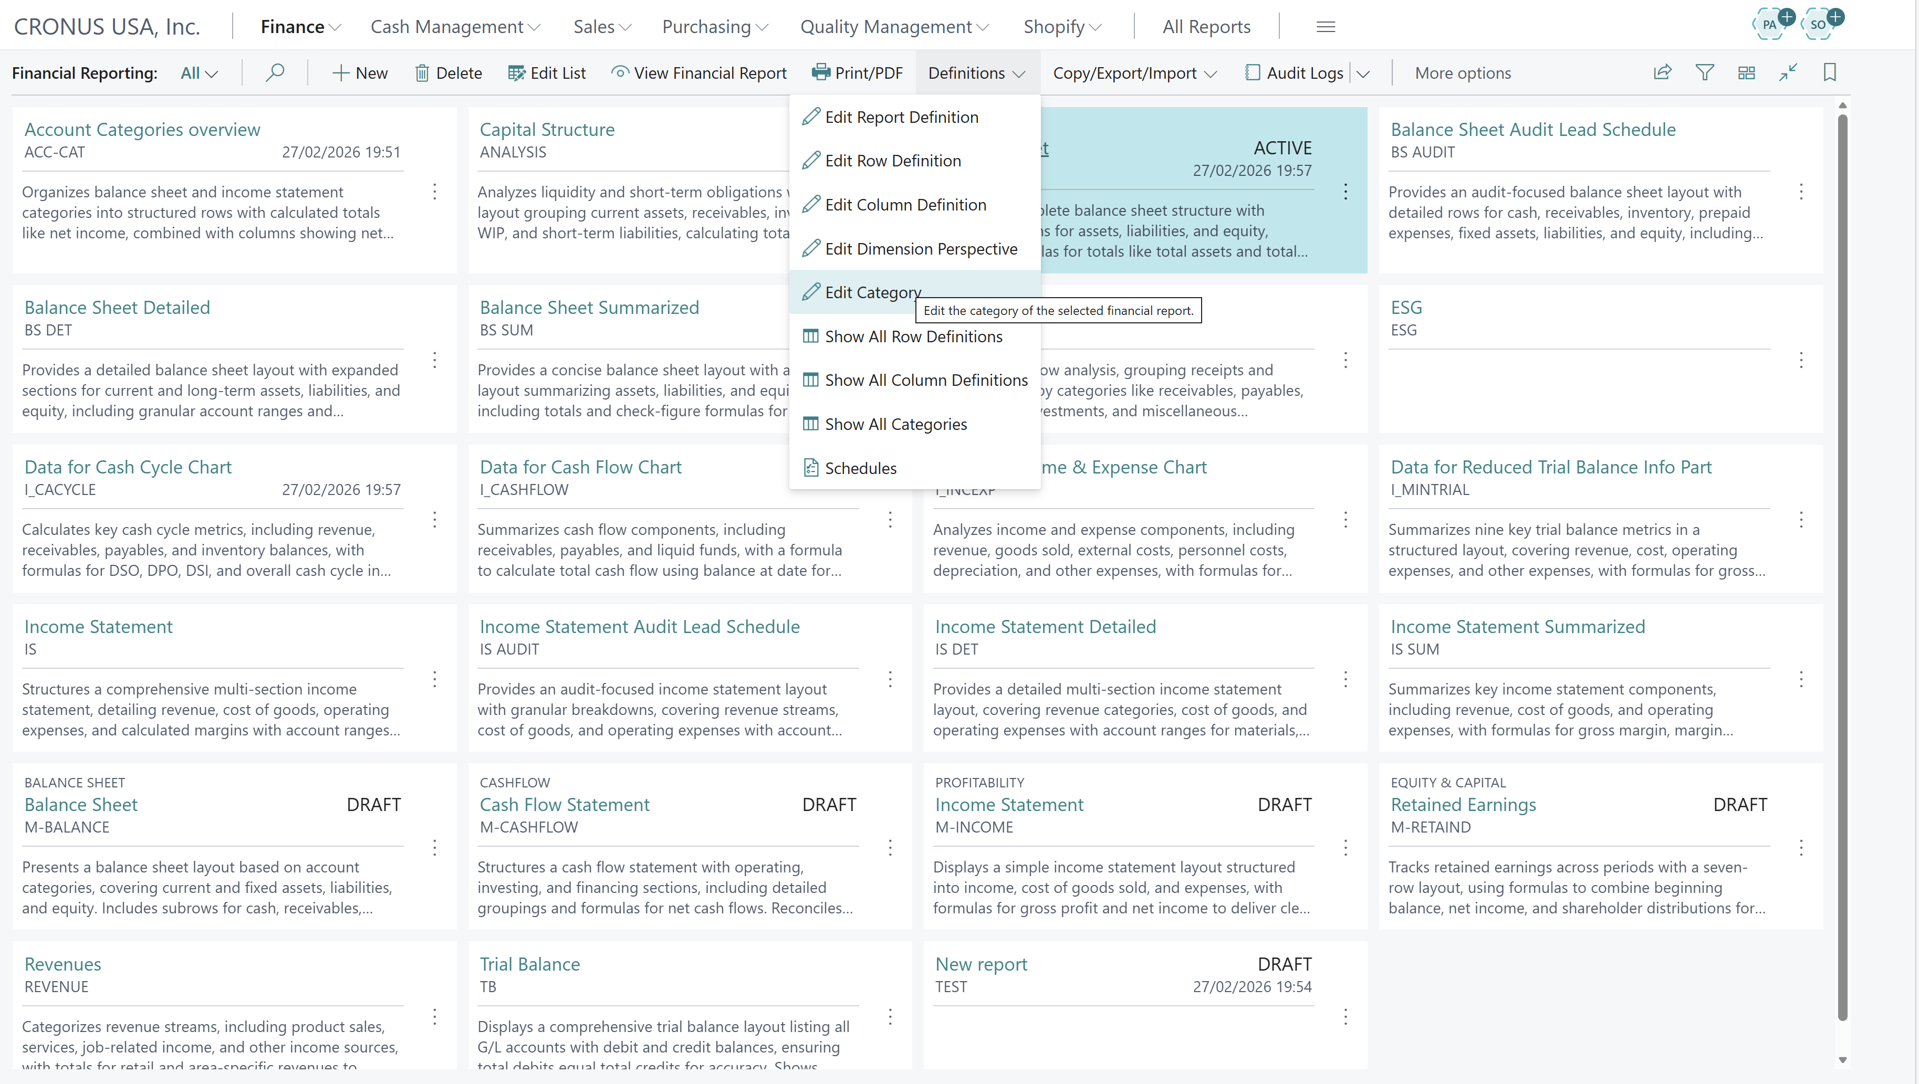
Requires setting a feature management setting

Slide 9
Analysis tabs added to finance pages (28.x)
GL registers
  GL entries by source
Fixed Assets Ledgers
  Fixed Assets (current value)
  Asset value changes over time
  FA depreciations over time

Slide 10
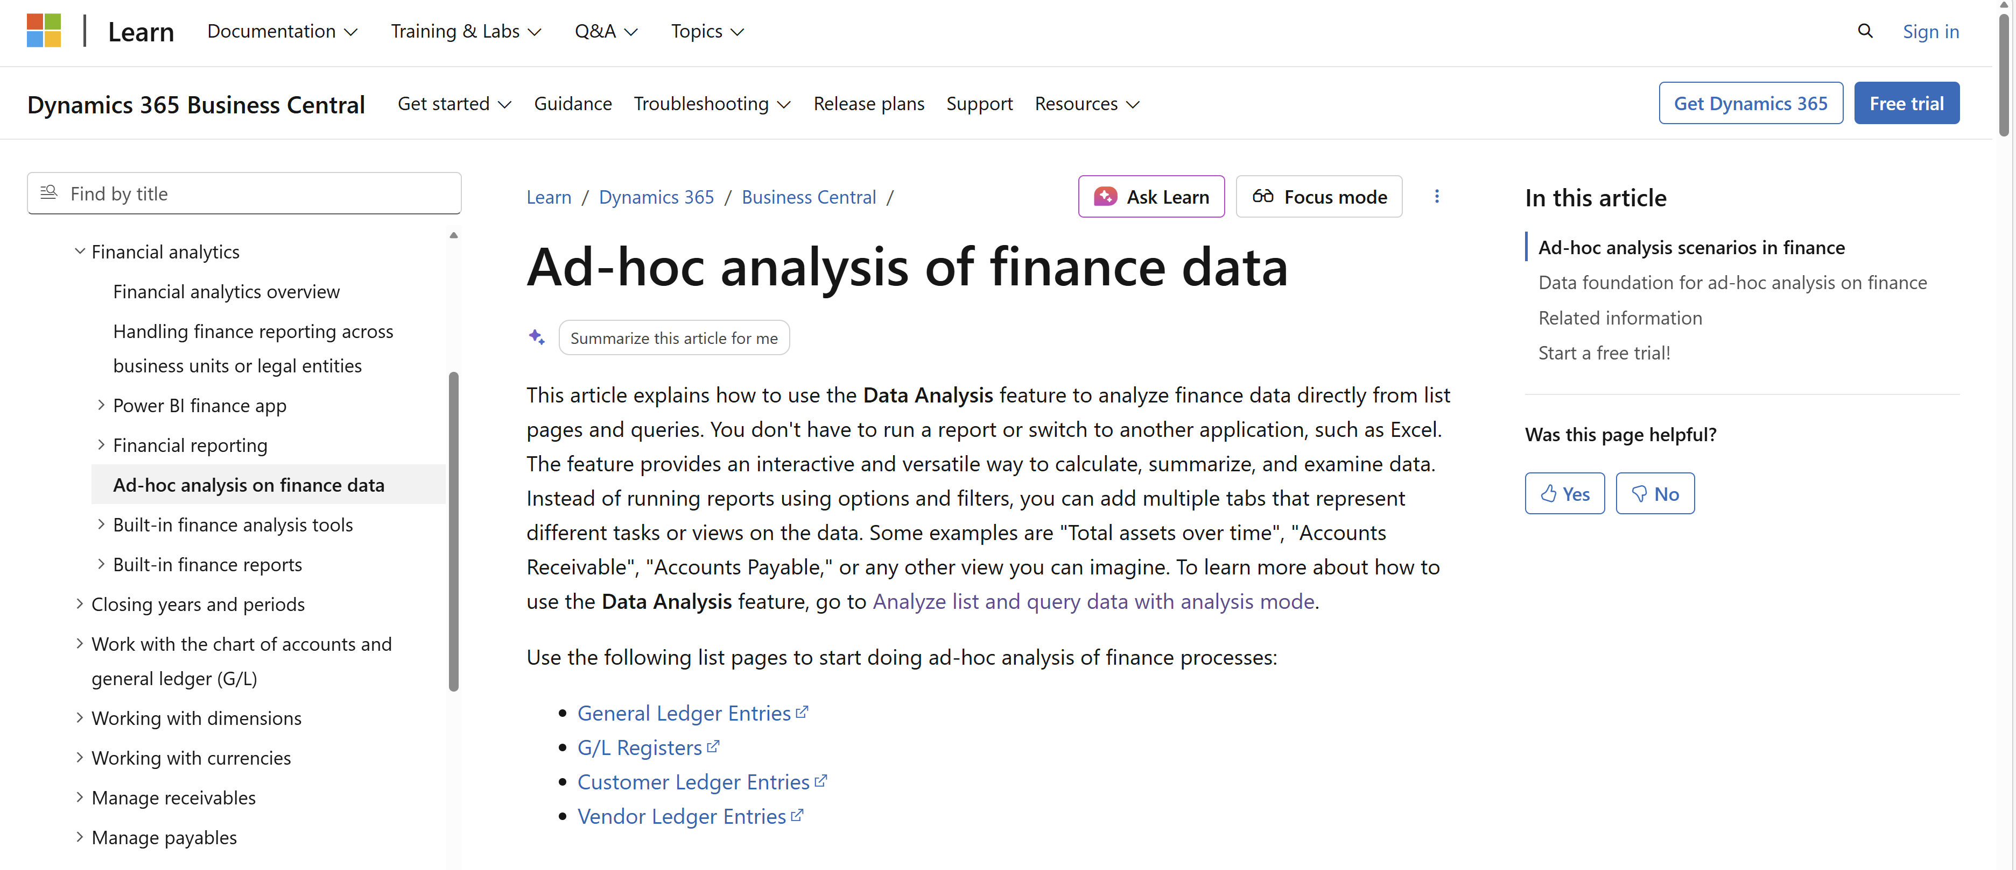
Find more examples in Microsoft Learn

Slide 11
Enhanced Financial Reporting (highlights)
New tile view
Categories
Lifecycle status
Company-specific defaults
Dimension perspectives
Scheduling
Audit log

Slide 12
Bonus: Enhanced demo data for Fixed Assets
Added transaction data (acquisitions and depreciations)
Allows for better demos on
Fixed Asset Details (Excel)
Fixed Asset Analysis (Excel)
Fixed Asset Projected Value (Excel)
Fixed Assets Ad-hoc Analysis (query)
Analysis mode on Fixed Asset Ledgers and FA Registers

Slide 13
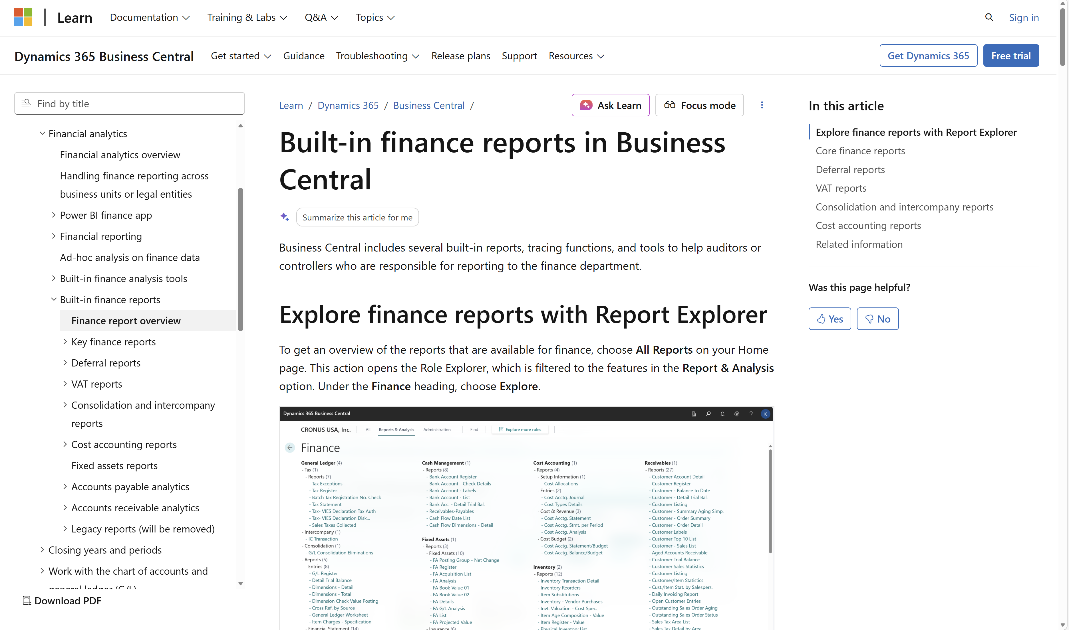
Want to learn more?
aka.ms/
bcFinanceAnalytics

Slide 14
Notes:
If pressed for time, why not do summaries on the articles

Slide 15
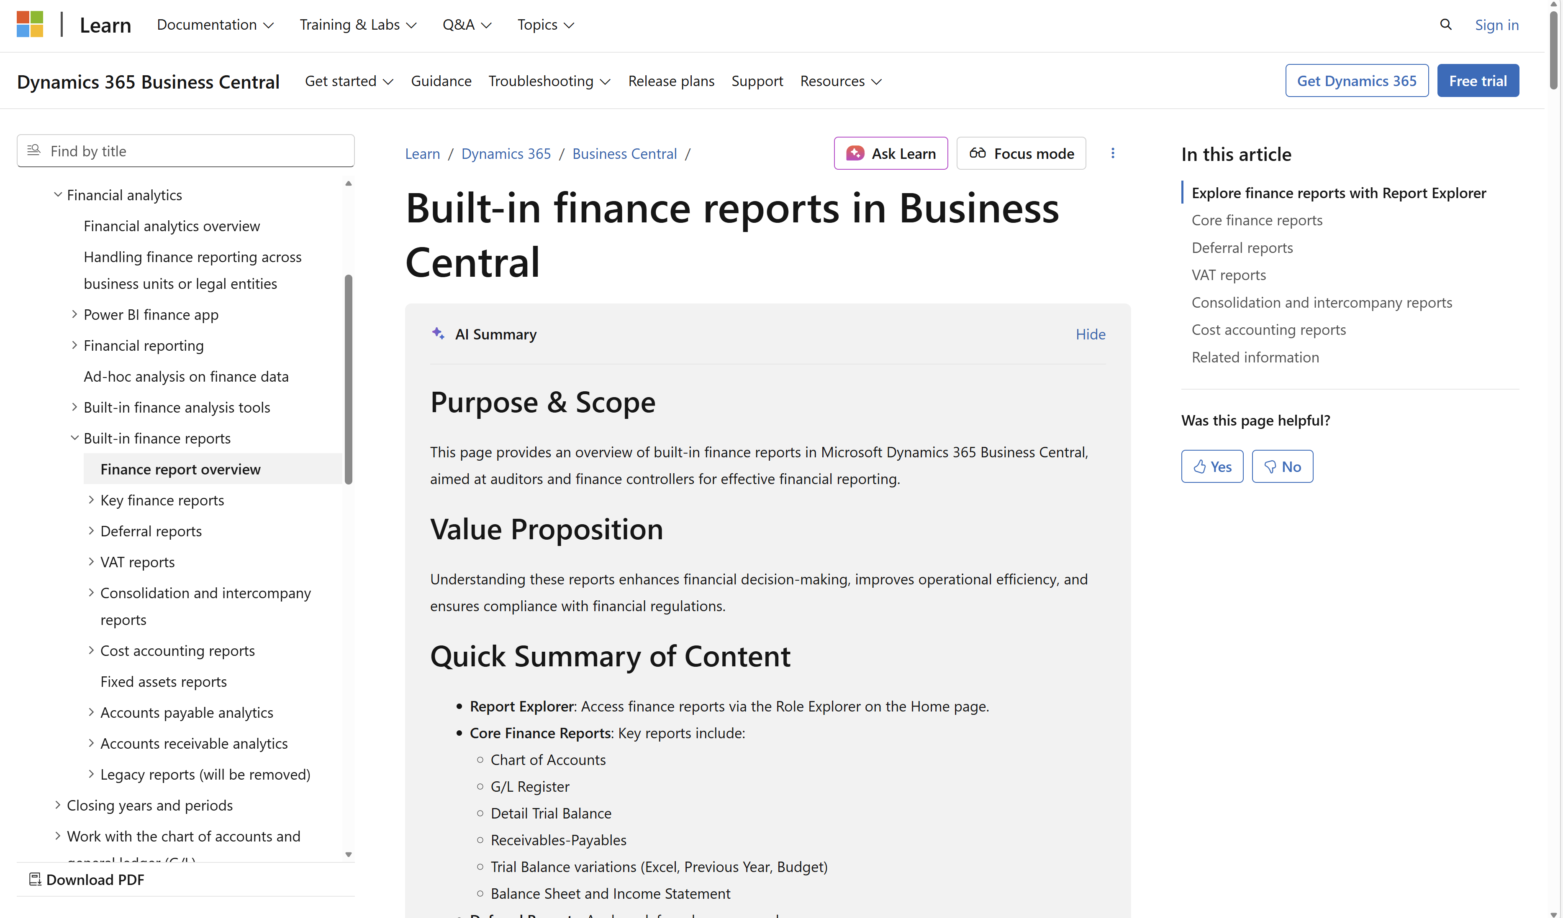

Slide 16
Enhanced Financial Reporting (related session)
New tile view
Categories
Lifecycle status
Company-specific defaults
Dimension perspectives
Scheduling
Audit log

Slide 17
Related sessions
What's new: Enhanced sales analytics
What's new: Enhanced inventory analytics
What's new: Enhanced Financial Reporting
What's new: Enhanced subscription billing analytics
What's new: Enhanced Power BI and Excel with Business Central
What's new: Enhanced Analysis Mode
What's new: Enhanced demo data

Slide 18
General Business Central resources
Learn more!
Looking for resources?
Watch more on YouTube
aka.ms/BCAll
aka.ms/BCYouTube
Join Viva Engage to ask questions
Follow on LinkedIn
aka.ms/BCLinkedIn
aka.ms/BCVivaEngage
Join the office hours
Microsoft page for partners
aka.ms/BCOfficeHours
aka.ms/BCPartnerPortal

Slide 19



LinkedIn
Follow the weekly news and announcements
on the Microsoft Dynamics 365 Business Central page
aka.ms/BCLinkedIn

Slide 20

Watch more videos on YouTube
One-stop shop to watch Business Central videos:
  What is new
  Copilot and AI
  Short tips and tricks
  Technical deep dives
  Under the Hood podcast series
aka.ms/BCYouTube

Slide 21
THANK YOU

